Slide 1
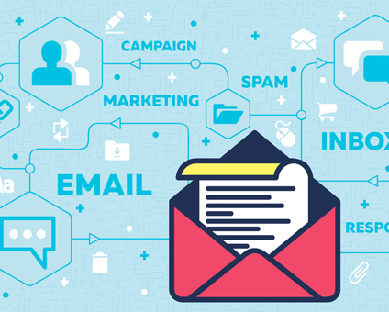
Background
Manage demand To know which person is responsible for the wrong security code.
Notes:
Report Inquiry Log is used to check whether the printers are correctly functioning and have printed the assigned documents.
Letting users print out the report log can let them check the failed printers with the hard-copied of the report log,
so that they don’t need to return to the system to check the report log every time.

Slide 2
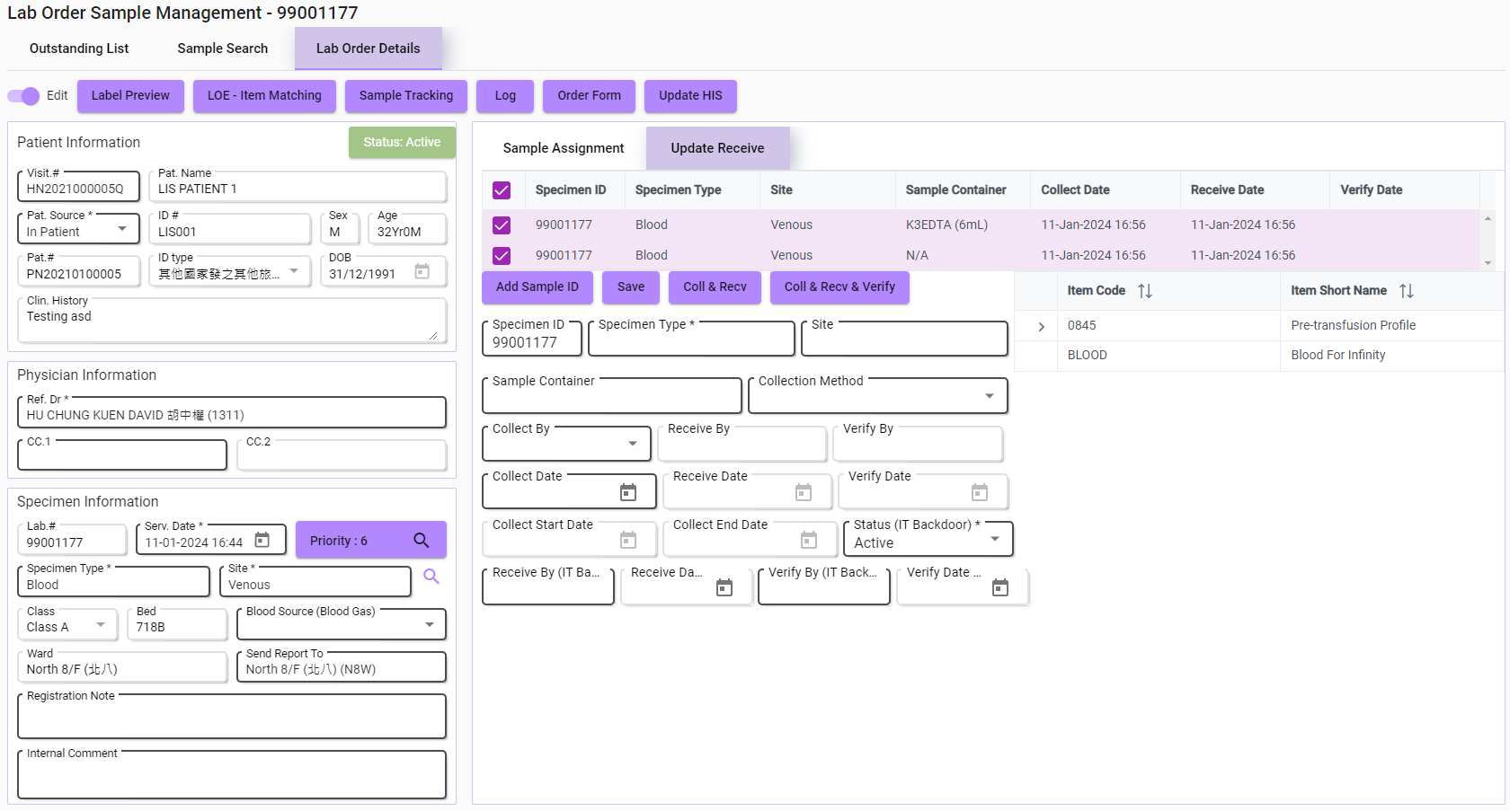
Verify
When to trigger
Verify the order sample
Notes:
For the export PDF button, a preview screen will be opened on the browser for previewing or downloading.
This is the content inside the PDF file, clearly displaying the search result of the report log.
Users can print this PDF out and bring it to check failed printers.

Slide 3
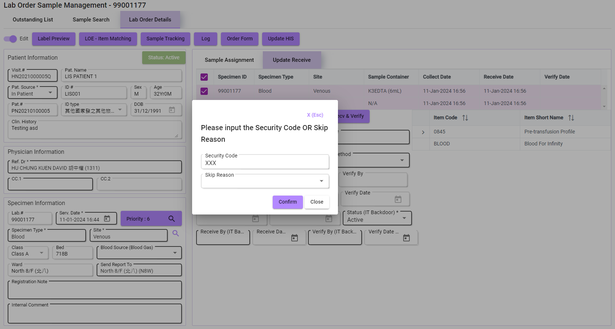
When to trigger
Enter Incorrect Security Code
Notes:
For the export PDF button, a preview screen will be opened on the browser for previewing or downloading.
This is the content inside the PDF file, clearly displaying the search result of the report log.
Users can print this PDF out and bring it to check failed printers.

Slide 4
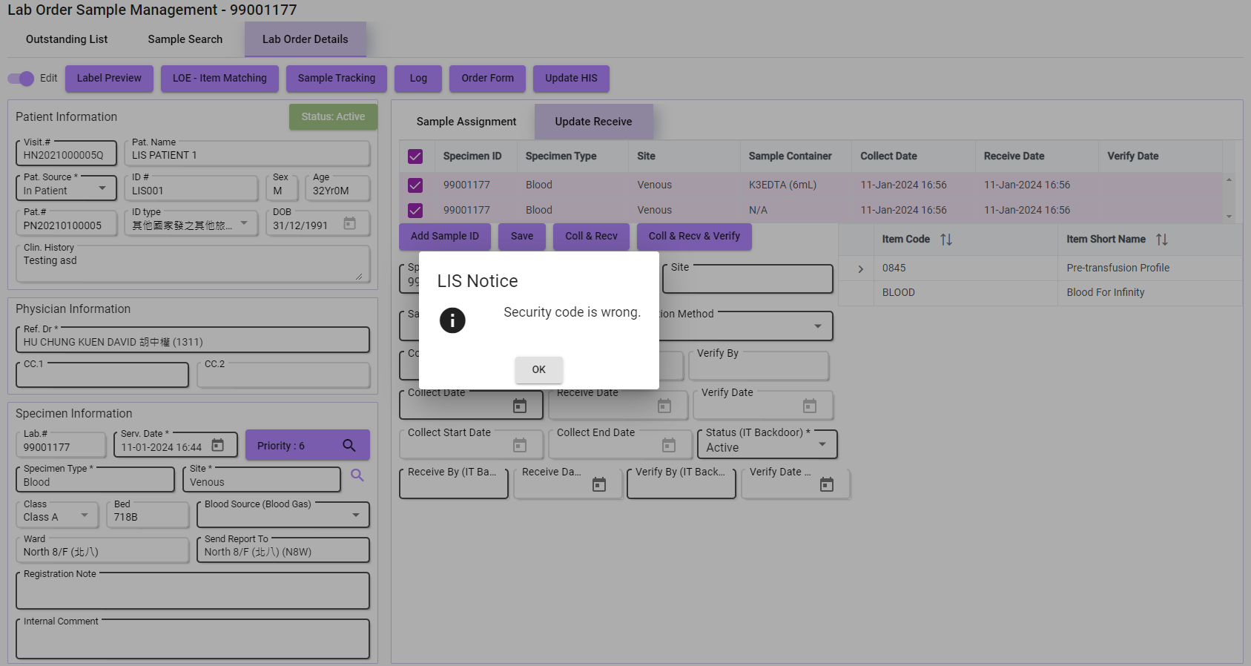
Email Notification Sent
Notes:
For the export PDF button, a preview screen will be opened on the browser for previewing or downloading.
This is the content inside the PDF file, clearly displaying the search result of the report log.
Users can print this PDF out and bring it to check failed printers.

Slide 5
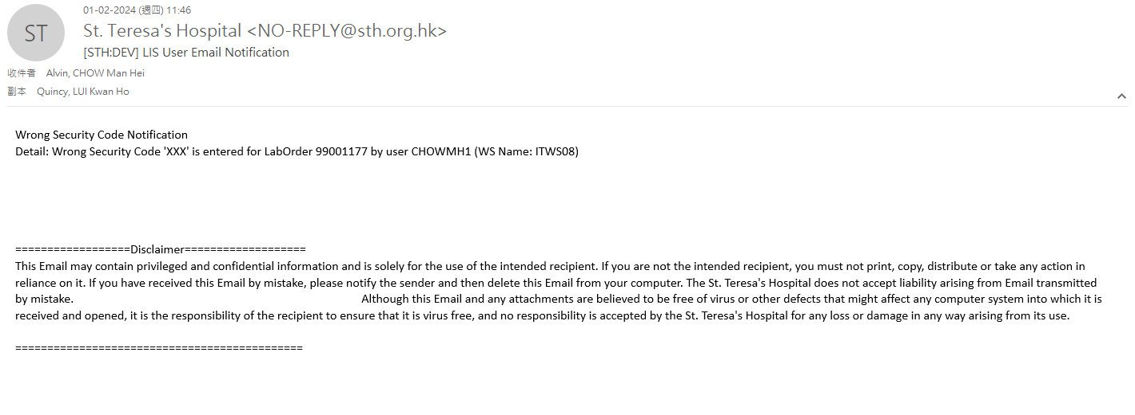
Received Email
Notes:
For the export PDF button, a preview screen will be opened on the browser for previewing or downloading.
This is the content inside the PDF file, clearly displaying the search result of the report log.
Users can print this PDF out and bring it to check failed printers.

